Slide 1
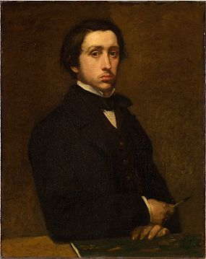
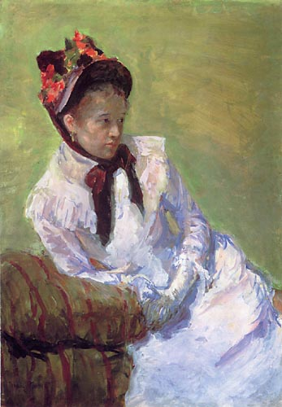
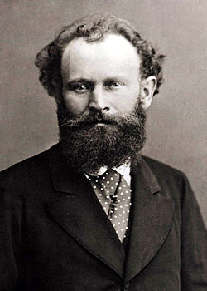
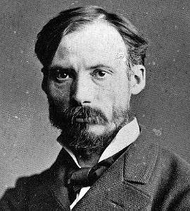
Welcome to the 2013 Impressionist Appreciation Exhibit
Presented to you by: Jillian Curl, Avery Crow, and Nana Fordjour
Notes:
Theater, Opera, and Dance as portrayed by the Impressionists Degas, Cassatt, Manet, and Renoir

Slide 2
Renoir, The Loge (1874)

Slide 3
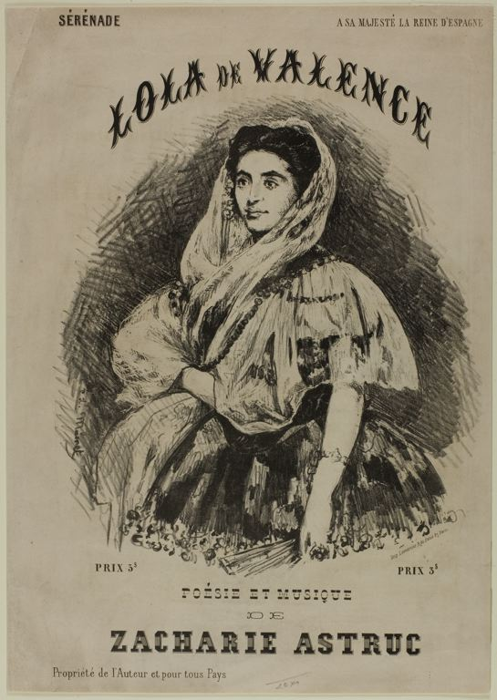
Manet, Lola de Valence (1862)

Slide 4
At the Opera, Damourette (1852)

Slide 5
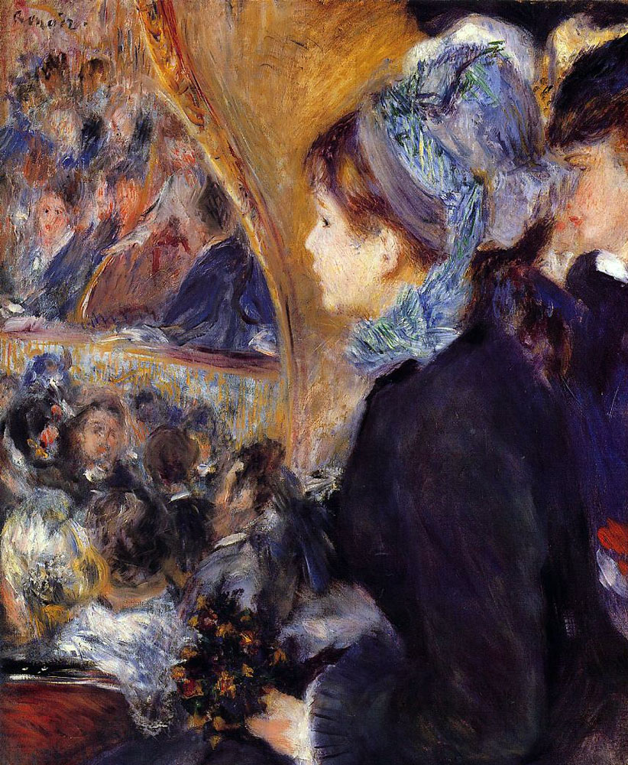
Woman in Black at the Opera, Cassatt (1879)
The First Outing, Renoir (1875-76)

Slide 6
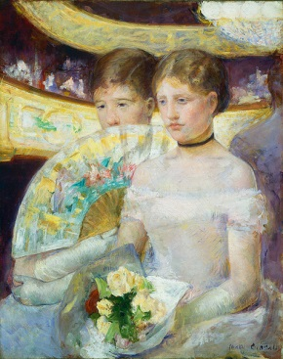
Two Young Women in a Loge, Cassatt (1882)
At the Concert, Renoir (1880)
Notes:
SKIT

Slide 7
Dancer with a Bouquet, Degas (1877-1879)

Slide 8
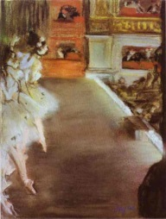
Dancers at the Old Opera House, Degas (1877)
The Prima Ballerina , Degas (1876)
Notes:
The Golden Mean, or the balance of a big gulf of space and the people, was prominent in both of the Degas works. In both paintings Degas’ use of the privileged view is also prevalent. However, it seems as though the perspective is more of a sidestage view rather than from a boxed seat. In Dancers at the Old Opera House, it seems as though we are viewing the dancers from either the privileged perspective OR from the perspective of the predatory male waiting in the curtains. The Prima Ballerina is indicative of the portrayal of this predatory male. The men would often consume the dancers, not only as a spectacle, but also as a possession before and after the show. Degas depicts this in many of his dance themed works where the male lurks in the curtains or sidestage.

Slide 9
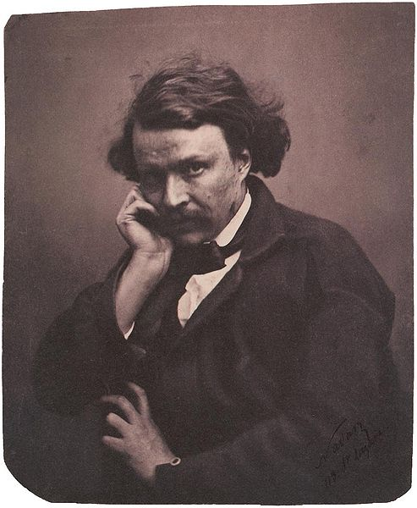
Felix Nadar , (1820-1910)
Notes:
Degas was good friends with Nadar, a photographer, who was very influential in his work. Degas’ work included cropping which evoked an illusion of spontaneity in the before and after moments of an event rather than the “big moment”.

Slide 10
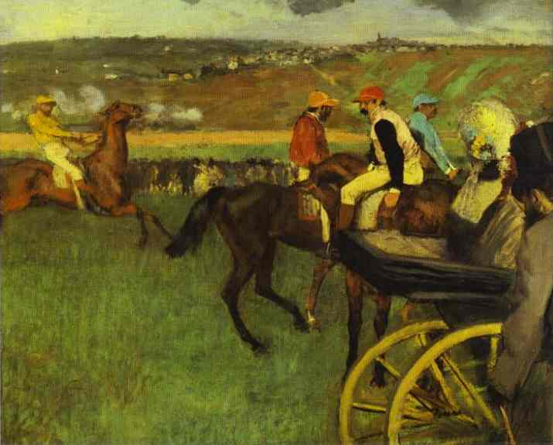
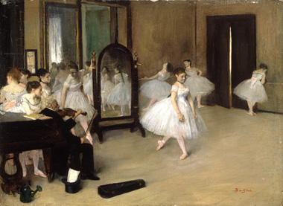
At the Horse Races, Degas (1876)
Dance Class, Degas (1872)
Notes:
The influence of photography in Degas’ work is shown in this comparison of his 1876 painting, At the Horse Races and his 1872 painting, Dance Class. Although themed differently, both of these paintings depict the smaller and more spontaneous moments that precede the actual performance.

Slide 11
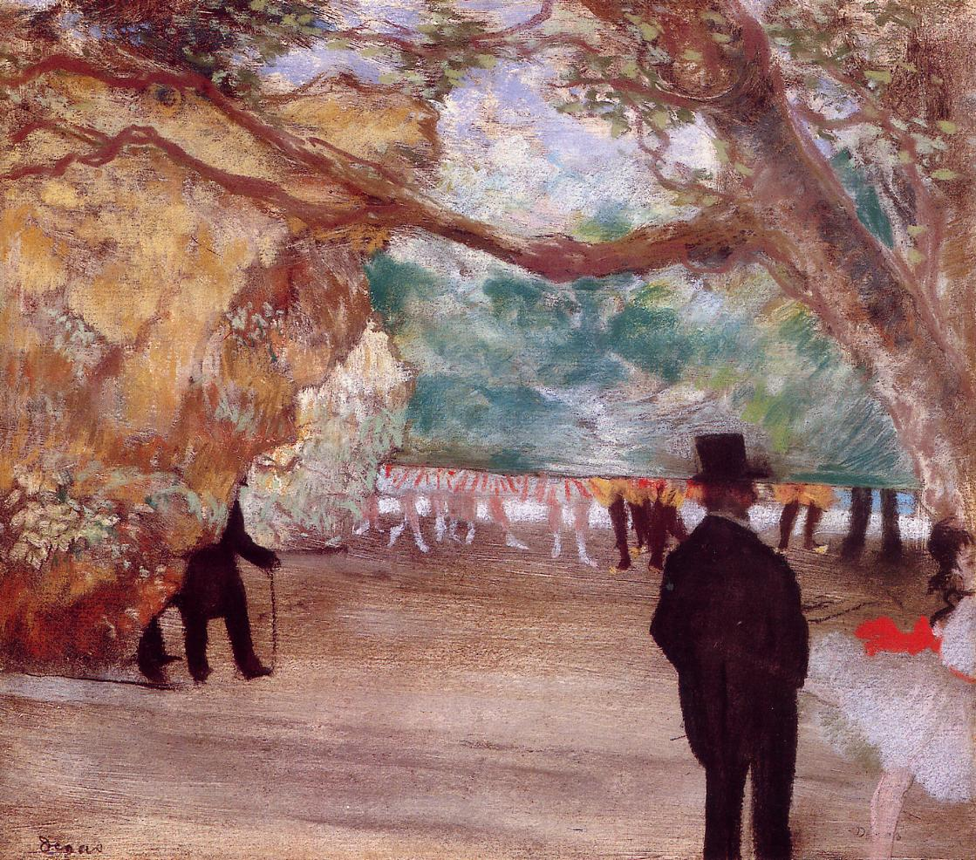
The Curtain, Degas (1880)

Slide 12
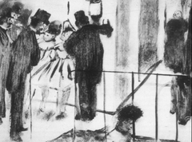
La Famille Cardinal, Degas (1880-83)
Notes:
La Famille Cardinal: Pauline and Virginie Conversing with Admirers

Slide 13
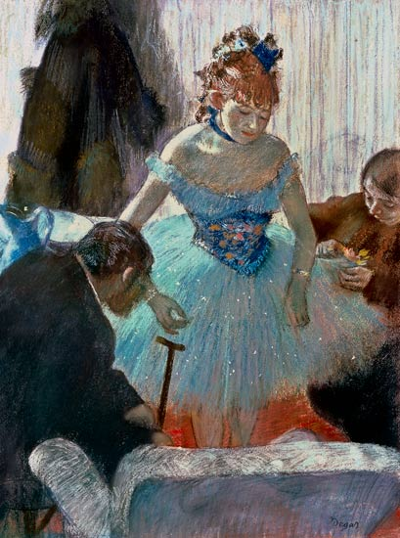
Dancer’s Dressing Room, Degas (1878)
Notes:
La Famille Cardinal: Dancers Coming from the Dressing Room (sketch) compared with this

Slide 14
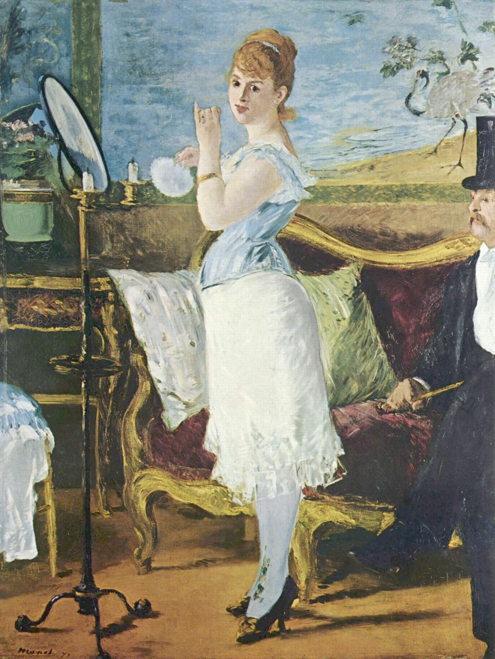
Degas (1879)
Manet (1877)
Notes:
Women look like dogs in Degas’ Waiting for the Client. No class and almost dirty as they wait for the men. Compared to Degas’ Nana who looks classy and clean

Slide 15
Preparation for the Dance, Degas (1877)
Notes:
Mothers in dance

Slide 16
Waiting, Degas (1882)
Notes:
Mothers in dance

Slide 17
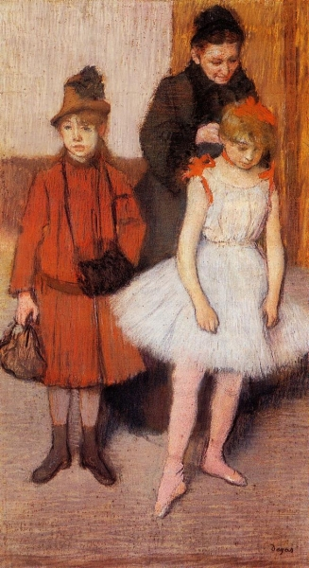
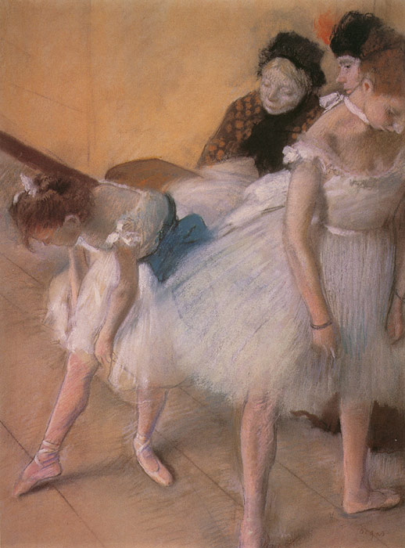
The Manet Family, Degas (1880)
Before the Rehearsal, Degas (1880)
Notes:
Mothers in dance

Slide 18
The Rehearsal, Degas (1874)

Slide 19
The Dance Class, Degas (1875)

Slide 20
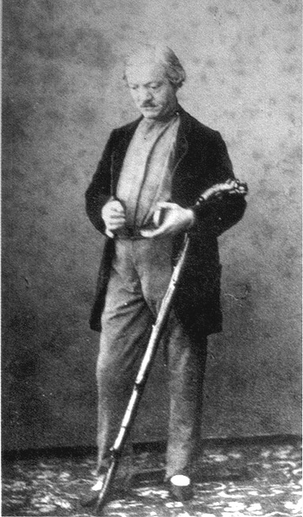
Jules Perrot, Bergamasco (1861)

Slide 21
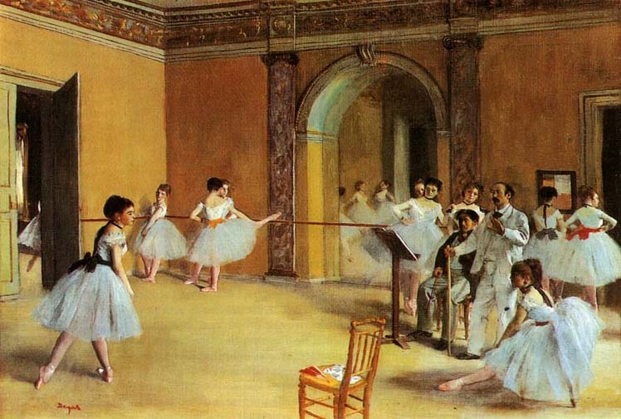
The Dance Lesson, Degas (1872)
Notes:
Compared to next slide

Slide 22
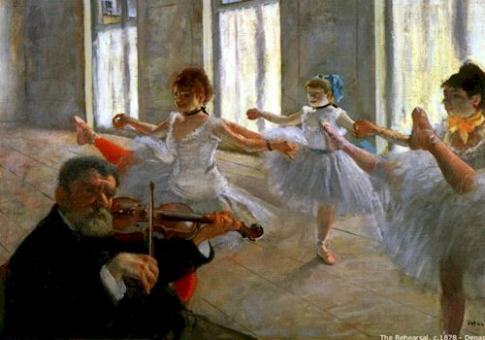
The Rehearsal, Degas (1879)

Slide 23
Masked Ball at the Opera, Manet (1873)
Notes:
Compared to next slide

Slide 24
La Moulin de la Galette, Renoir (1876)

Slide 25
The Shepherds, Watteau (1718-19)

Slide 26
Moulin de la Galette (1900)

